Slide 1
Support Vector Machine

Slide 2
Contents
Support Vector Machine - Ramya
Hyperplane & N-Dimensional Space - Ramya
Linear SVM - Pooja
Learning a Linear SVM Model- Nikhil
Example of Linear SVM - Akarsh
Linear SVM :Non-separable case - Divya
Nonlinear Support Vector Machines - Hari Chandana
Learning Nonlinear SVM Model - Di Zhang
Issues and Kernel Trick - Satabdhi
Example of Nonlinear SVM - Raqib
Advantages and disadvantages of SVM - Sarang
Characteristics & Applications of SVM - Medha

Slide 3
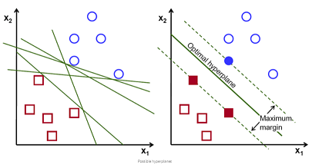
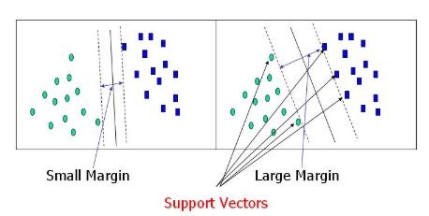
Support Vector Machine
What is Support Vector Machine ?
The process of finding a hyperplane in an N-dimensional space(N — the number of features) that distinctly classifies the data points is called Support Vector Machine.
What are Support vectors?
The points that are closer to the hyperplane and influence the position and orientation of the hyperplane.
Adding or deleting the support vectors will change the position of the hyperplane.
Notes:
What is Support Vector Machine?
The objective of the support vector machine algorithm is to find a hyperplane in an N-dimensional space(N — the number of features) that distinctly classifies the data points
Support vectors
Support vectors are data points that are closer to the hyperplane and influence the position and orientation of the hyperplane. Using these support vectors, we maximize the margin of the classifier. Deleting the support vectors will change the position of the hyperplane. These are the points that help us build our SVM.

Slide 4
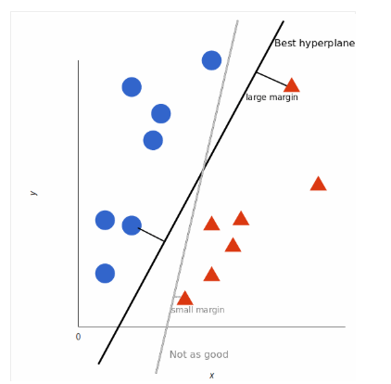
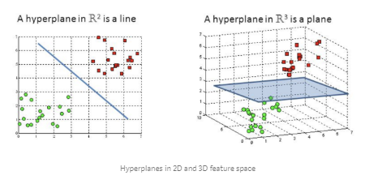
Hyperplane & N-Dimensional Space
What is the best possible hyperplane ?
Many possible hyperplanes that could be chosen but we need to find the maximum margin so that future data points can be classified with more confidence.
Hyperplane in N-dimensional Space
Dimensions of the hyperplane depends upon the number of features.
Number of input features is 2 : hyperplane is just a line.
Number of input features is 3 : hyperplane is a 2D plane.
Question: what is meant by margin?
Notes:
What is best possible hyperplane?
To separate the two classes of data points, there are many possible hyperplanes that could be chosen. Our objective is to find a plane that has the maximum margin, i.e the maximum distance between data points of both classes. Maximizing the margin distance provides some reinforcement so that future data points can be classified with more confidence.
Hyperplanes and Support Vectors - n dimensional plane
Hyperplanes are decision boundaries that help classify the data points. Data points falling on either side of the hyperplane can be attributed to different classes. Also, the dimension of the hyperplane depends upon the number of features. If the number of input features is 2, then the hyperplane is just a line. If the number of input features is 3, then the hyperplane becomes a two-dimensional plane. It becomes difficult to imagine when the number of features exceeds 3.
Question
What is meant by Margin ?
Margin = Distance of closest tuples/points from the decision line/ hyperplane

Slide 5
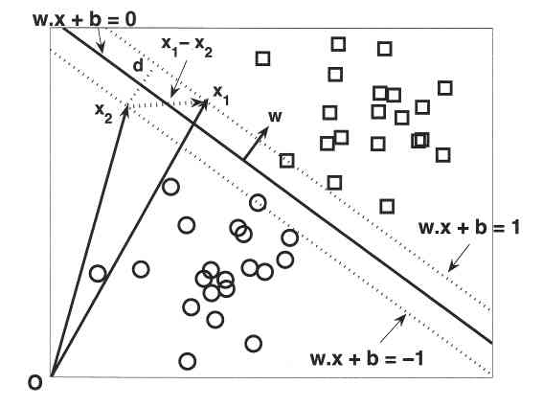
Linear SVM
A linear SVM is a classifier that searches for a
hyperplane with the largest margin
Classifies data into 2 classes
Linear SVM In 2 dimensional space - Line
In 3 dimensional space - Plane
Decision boundary of linear classifier can be written in form
w . x + b = 0
Positive Plane (+1) if w . x + b > 1
Negative Plane (-1) if w . x - b < -1
If x₁, x₂ are 2 points margin (x₁ - x₂)
D = 2 / ( ||w|| )
Data is linearly separable if it can be separated perfectly
by a hyperplane

Slide 6
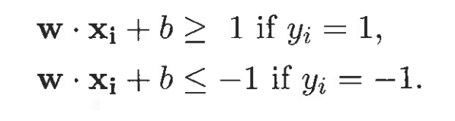
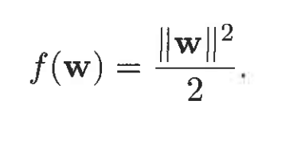
Learning a Linear SVM Model
The training phase of SVM involves estimating the parameters w and b of the decision boundary from the training data. The parameters must be chosen in such a way that the following two conditions are met:
These conditions impose the requirements that all training instances from class gr : 1 (i.e., the squares) must be located on or above the hyperplane w.x* b: L, while those instances from class U: -I (i.e., the circles) must be located on or below the hyperplane w .x * b - -1.
Although the preceding conditions are also applicable to any linear classifiers (including perceptrons), SVM imposes an additional requirement that the margin of its decision boundary must be maximal. Maximizing the margin, however, is equivalent to minimizing the following objective function:

Slide 7


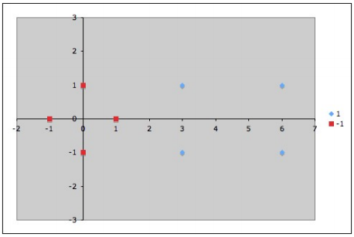
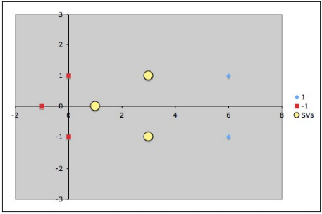
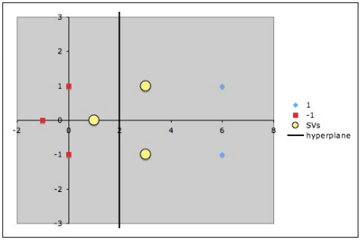

Example of Linear SVM
Assume our dataset has two classes as follows:
Class A data = Class B =
The dataset can be visually plotted on the x-y plane as seen in the Fig. 1 below:
Fig 1. Fig 2. Fig 3
Our objective is to find a linear SVM which can classify the given dataset.
Assume that our support vectors are chosen to be as seen in Fig. 2 above;

Slide 8


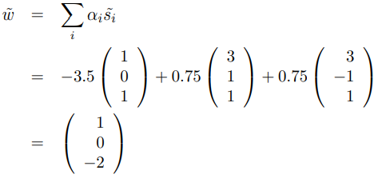


Example of Linear SVM Cont.
From the 3 support vectors, we get 3 equations.
Assume ɸ as Identity, we get the equations as follows:
Finally substituting the dataset into the above equations and solving for solution. We get the values of ɑ1, ɑ2 and ɑ3 as -3.5, 0.75 and 0.75 respectively. Finally, we can get the hyperplane that classifies the dataset using the line equation. The hyperplane is shown in Fig 3 - of previous slide.

Slide 9
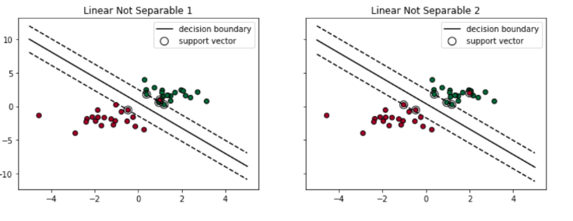
Linear SVM - NON SEPARABLE CASE
SVM addresses non-linearly separable cases by introducing two concepts:
Soft Margin and Kernel Tricks.
1.Soft Margin:
SVM tolerates a few dots to get misclassified;
Tries to balance the trade-off between finding a line that maximizes the margin and minimizes the misclassification.
Degree of tolerance:
Important hyper-parameter for the SVM
Represented as the penalty term - ‘C’.
The bigger the C→ the more penalty

Slide 10
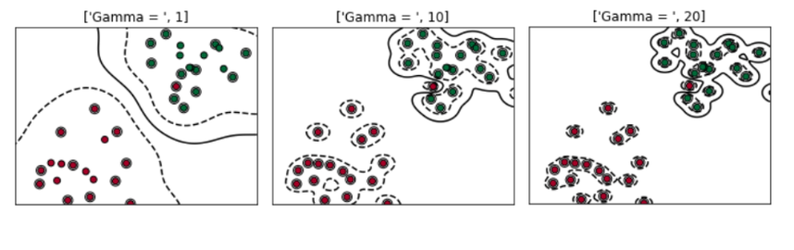
Linear SVM - NON SEPARABLE CASE
2.Kernel Tricks:
try to find a non-linear decision boundary
Process: utilizes existing features→ applies some transformations→ creates new features
Types: 1. Polynomial Kernel
2. Radial Basis Function (RBF) kernel
Degree of tolerance:
hyper-parameter is Gamma
Gamma is small→ influence is small
Gamma is big, → influence increases → the decision boundary get wiggled
Gamma is too big → influence too much → the decision boundary get too wiggled

Slide 11
Non Linear SVM
Non linear SVM are used to project the data that is not linearly separable into a higher dimensional space .
A nonlinear transformation is needed to map the data from its original feature space into new space where the decision boundary becomes linear.
After doing the transformation different methodologies are used to find a linear decision boundary in the transformed space.
In the transformed space parameters can also be found.
One potential problem with this approach is that it may suffer from the curse of dimensionality problem often associated with high-dimensional data.
Non linear SVM can avoid this problem by using kernel trick.

Slide 12
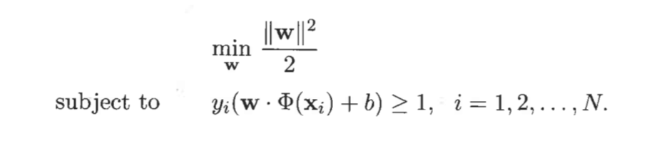
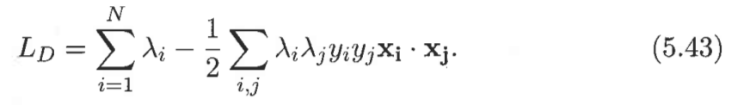
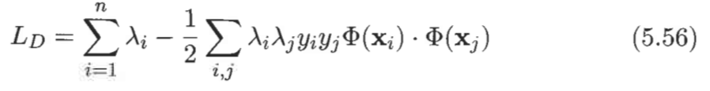
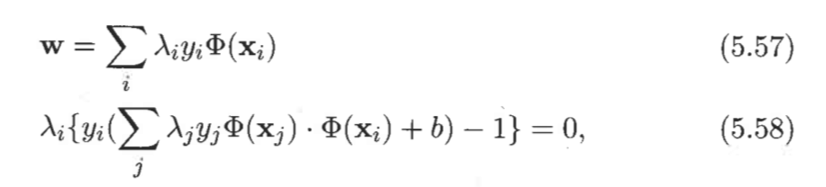
Learning a Non-linear SVM model
Different from linear SVM model, we use φ(x) instead of x to represent the transformed high-dimensional features. Assume we already know the φ(x).
The formal expression of the non-linear SVM learning problem is :
Similar to the Lagrangian in linear SVM (left is linear version, right is non-linear version)
Similarly the non-linear version w and b are:

Slide 13
Issues in Non-Linear SVM
ISSUE: One potential problem with non-linear is that it may suffer from the curse of dimensionality problem often associated with high-dimensional data.
One possibility is to transform the data into an infinite dimensional space, but such a high-dimensional space may not be that easy to work with.
Second, even if the appropriate mapping function is known, solving the constrained optimization problem in the high-dimensional feature space is a computationally expensive task. After the transformation the linear decision boundary in the transformed space has the following form:

Slide 14
Kernel Trick
The kernel trick is a method for computing similarity in the transformed space using the original attribute set.
The dot product between two input vectors u and v in the transformed space can be expressed in terms of a similarity function in the original space:
The similarity function, K, which is computed in the original attribute space' is known as the kernel function.
Kernel functions used in nonlinear SVM must satisfy a mathematical principle known as Mercer’s theorem.

Slide 15

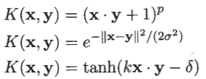
Mercer’s Theorem
MERCER’S THEOREM: Kernel function K can be expressed as
Examples of positive definite kernel:

Slide 16
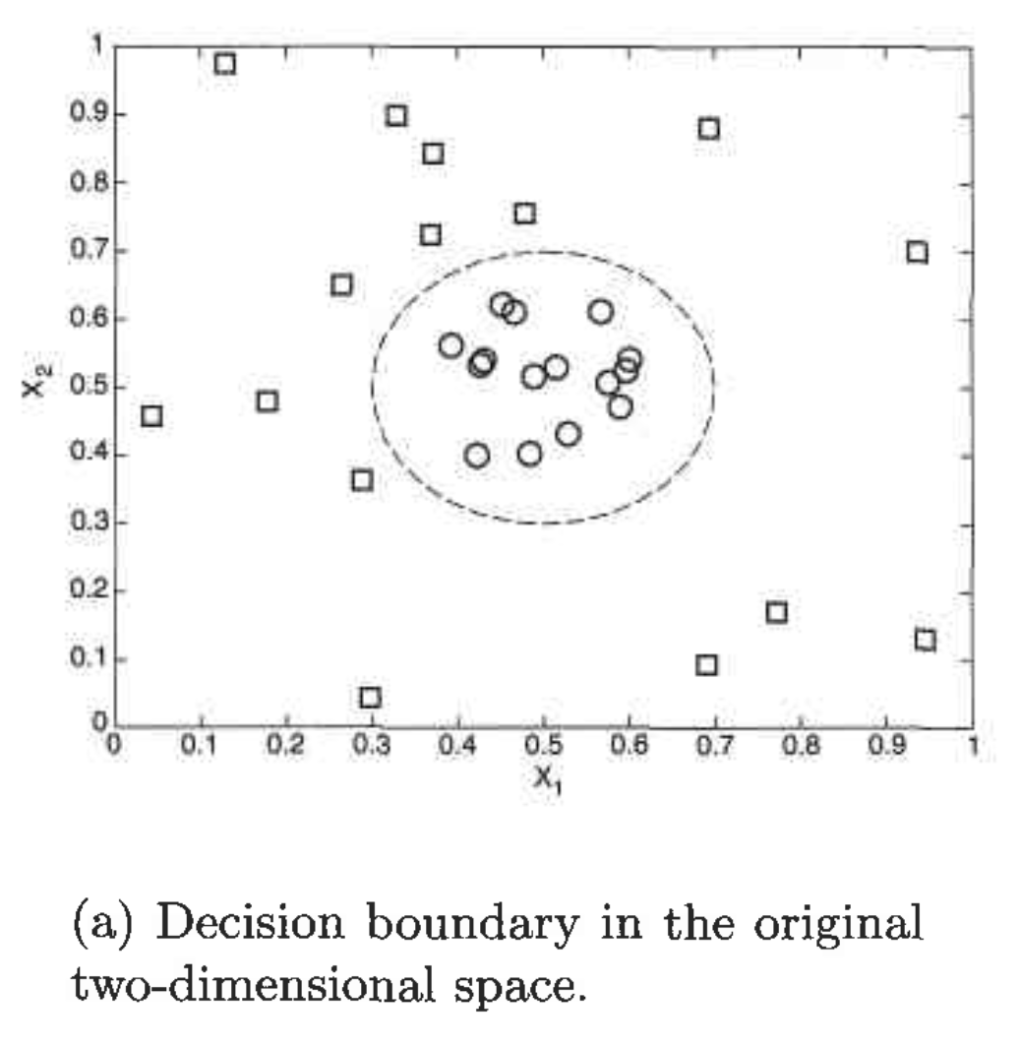
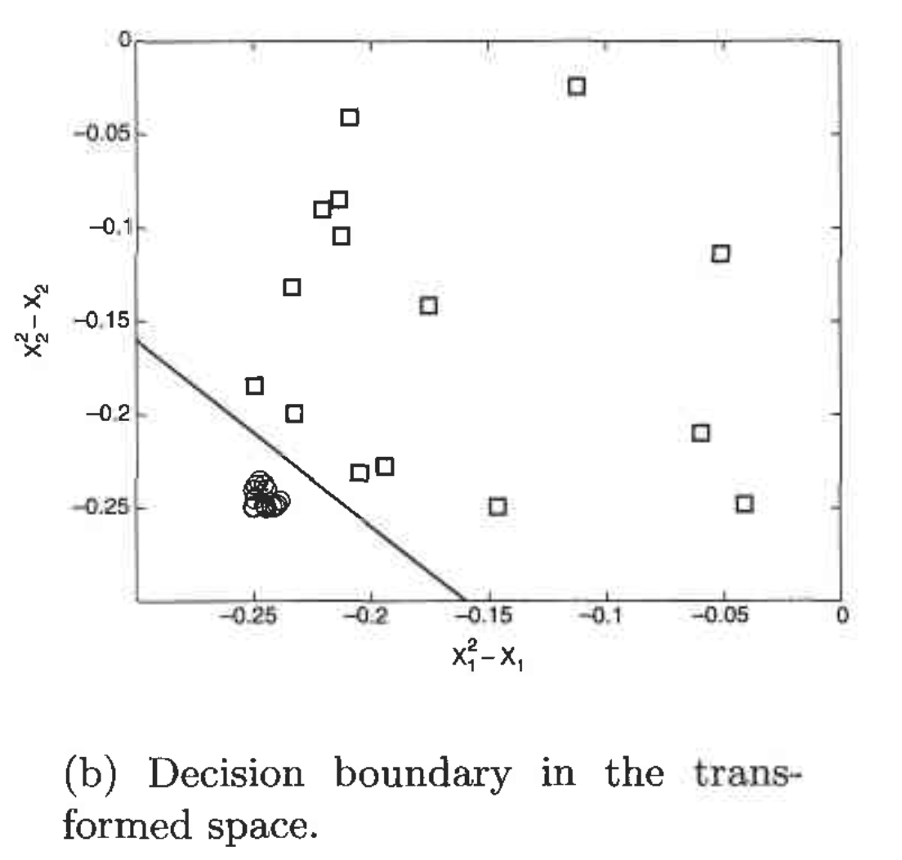
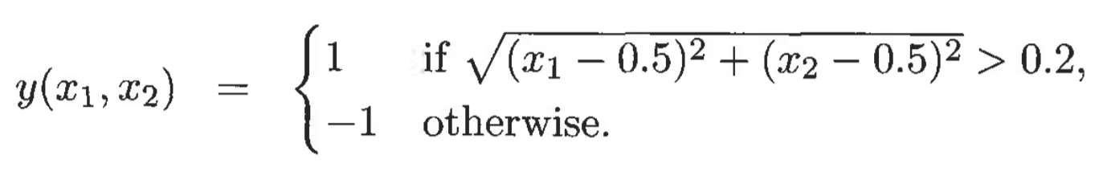
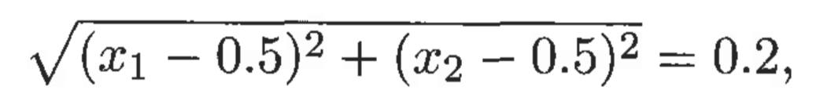
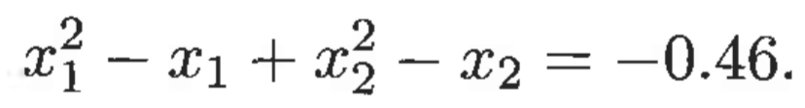
Example of Nonlinear SVM
Notes:
Hi everyone, I am Abdullah Al Raqibul Islam. I will give an example of applying SVM to data sets that have nonlinear decision boundaries.
I will show how we can apply a trick to transform the data from its original coordinate space in x into a new space phi(x) so that a linear decision boundary can be used to separate the instances in the transformed space. After doing the transformation, we can apply the methodology presented by Akarsh to find a linear decision boundary. I will show how we can transform the data.
The figure here shows an example of a two-dimensional data set consisting of squares (classified as y=1) and circles (classified as y=-1). From the dataset, we can see that, all the circles are clustered near the center of the diagram and all the squares are distributed farther away from the center. Our goal is to transform this data to this one so that we can draw a linear decision boundary like this.
Instances of the data set can be classified using this equation (eq 1). The decision boundary for the data can therefore be written as this (eq 2). Which can be further simplified into the this quadratic equation (eq 3). A nonlinear transformation Phi is needed to map the data from its original feature space into a new space where the decision boundary becomes linear. Suppose we choose this transformation (eq 4). In the transformed space,we can find the parameters w such that (eq 5)
For illustration purposes,let us plot the graph of (x2^2 - x2) versus (x1^2 - x1) for the previously given instances in Fig (a). In Figure(b) we can see that in the transformed space, all the circles are located in the lower right-hand side of the diagram. Now this problem is transformed into a Linear SVM problem and here a Iinear decision boundary can be constructed to separate the instances into their respective classes.

Slide 17
Example of Nonlinear SVM (cont.)
Question: What is the potential problem with this approach?
Notes:
Thank you for your question.
One potential problem with this approach is that it may suffer from the curse of dimensionality problem often associated with high-dimensional data. Satabdhi already showed how we can avoids this problem using kernel trick.

Slide 18
Advantages and disadvantages of SVM
Advantages:
SVM works relatively well when there is clear margin of separation between classes.
SVM is more effective in high dimensional spaces.
SVM is effective in cases where number of dimensions is greater than the number of samples.
SVM is relatively memory efficient.
Disadvantages:
SVM algorithm is not suitable for large data sets.
SVM does not perform very well, when the data set has more noise i.e. target classes are overlapping.
In cases where number of features for each data point exceeds the number of training data sample , the SVM will underperform.

Slide 19
Question
Can you list one advantage and one disadvantage of support vector machine ?

Slide 20
Characteristics of SVM
Since the learning problem is formulated as a convex optimization problem, efficient algorithms are available to find the global minima of the objective function (many of the other methods use greedy approaches and find locally optimal solutions)
Overfitting is addressed by maximizing the margin of the decision boundary, but the user still needs to provide the type of kernel function and cost function
Difficult to handle missing values
Robust to noise
High computational complexity for building the model

Slide 21
Real-World Applications of SVM
Helpful in text and hypertext categorization, as their application can significantly reduce the need for labeled training instances in both the standard inductive and transductive settings.
Classification of images can also be performed using SVMs. Experimental results show that SVMs achieve significantly higher search accuracy than traditional query refinement schemes.
Classification of satellite data like SAR data using supervised SVM.
Handwritten characters can be recognized using SVM.
The SVM algorithm has been widely applied in the biological and other sciences. They have been used to classify proteins with up to 90% of the compounds classified correctly.
Notes:
Question: State one application of the SVM which enables it to establish high search accuracy in comparison to a traditional query scheme?
Answer: Classification of Images

Slide 22
Thank You !!!

